Slide 1



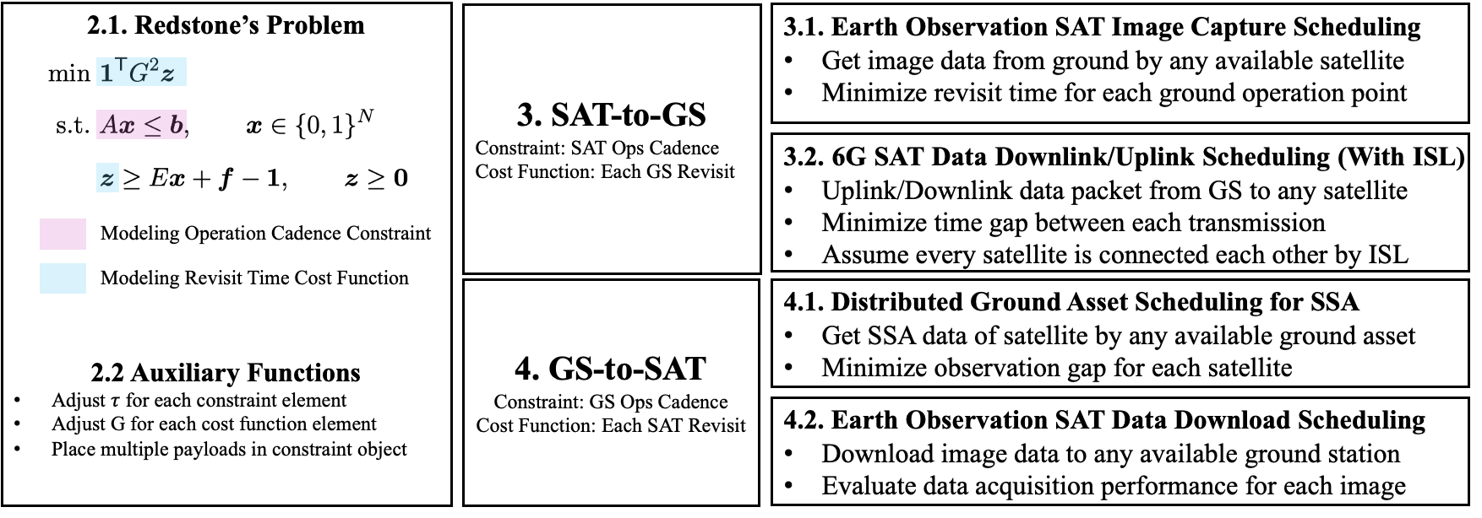

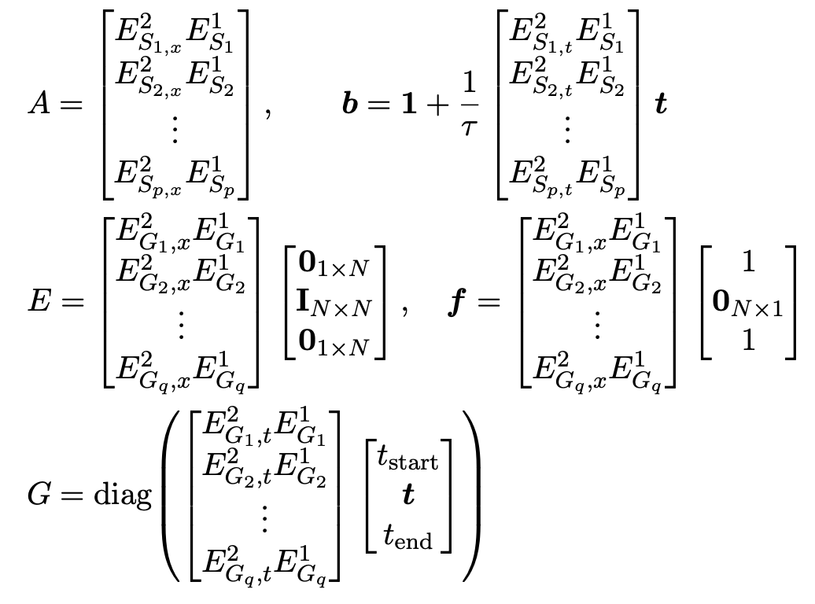
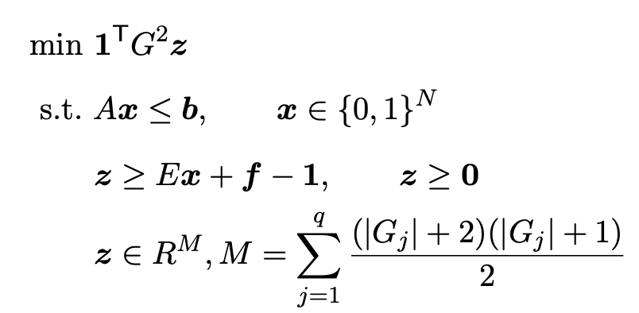
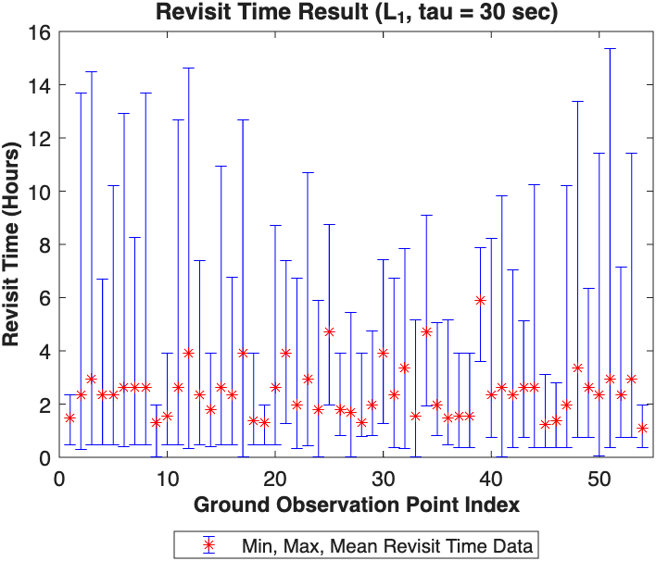
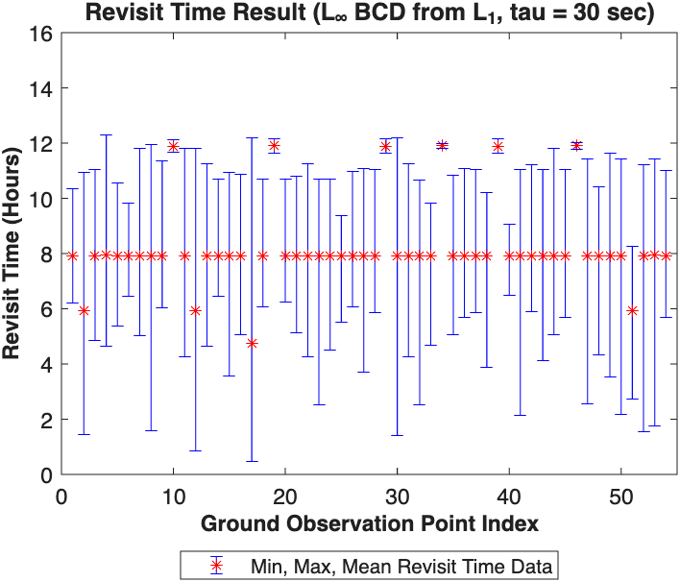
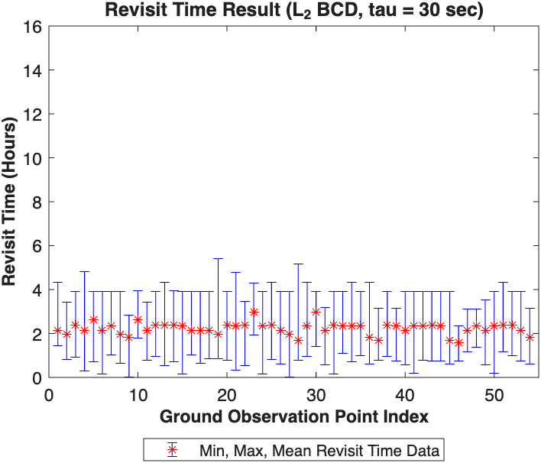
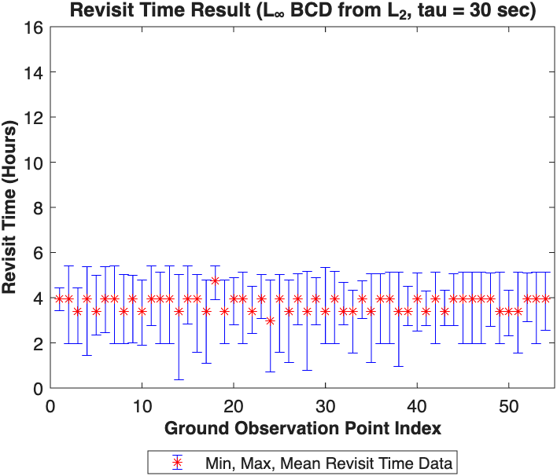
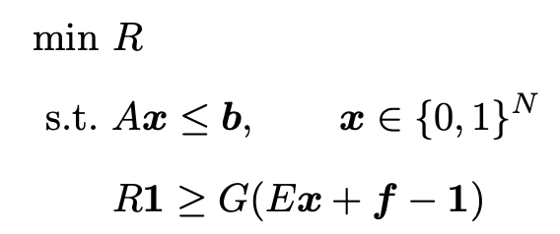
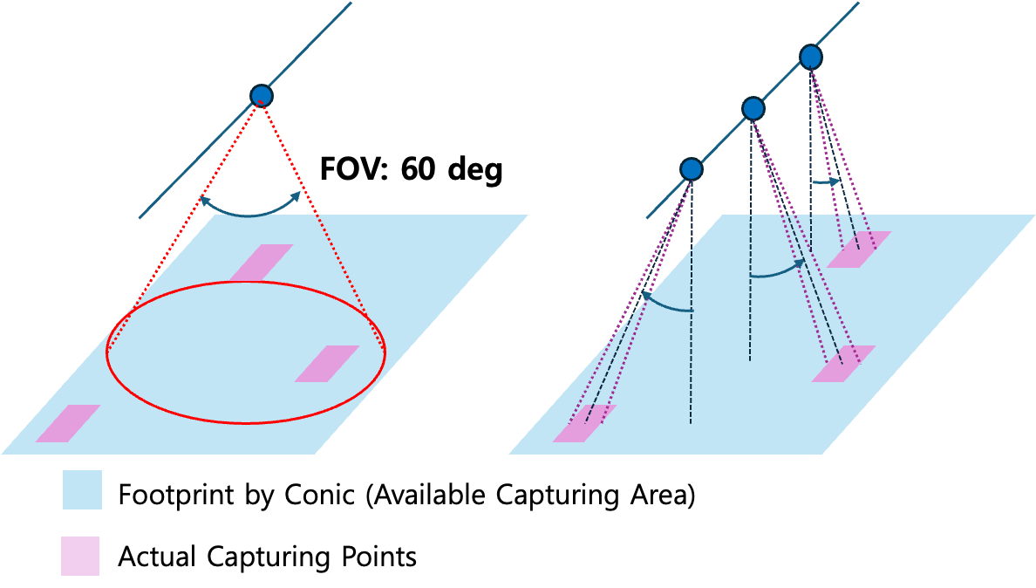
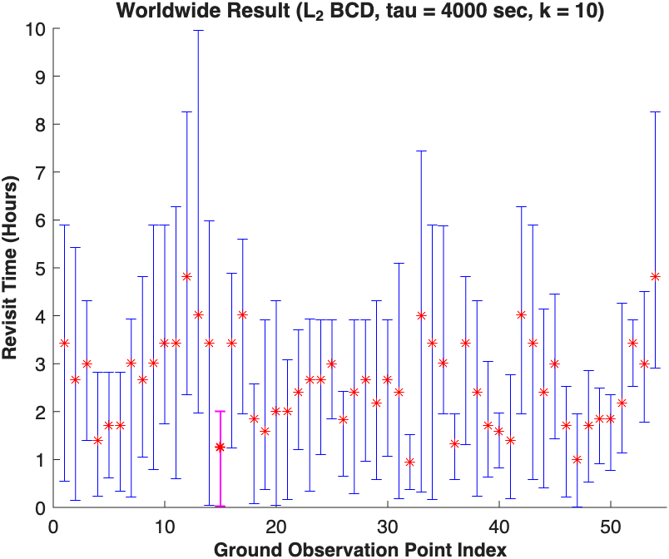

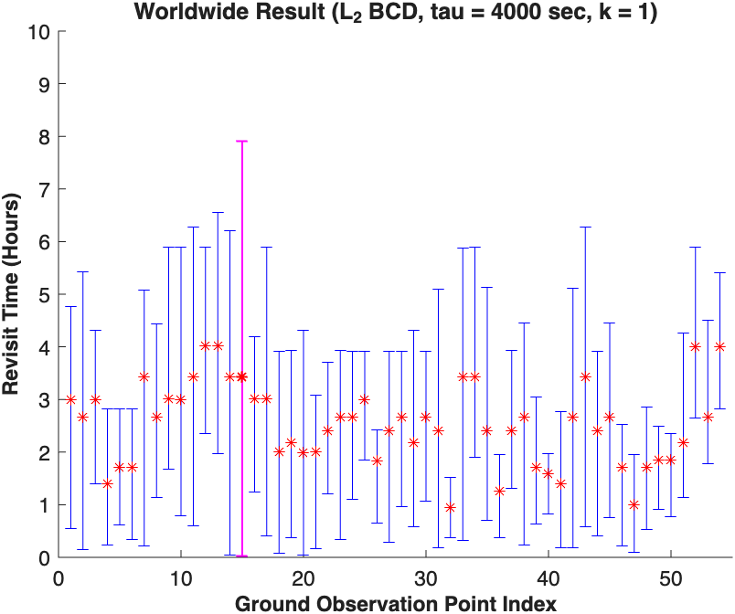
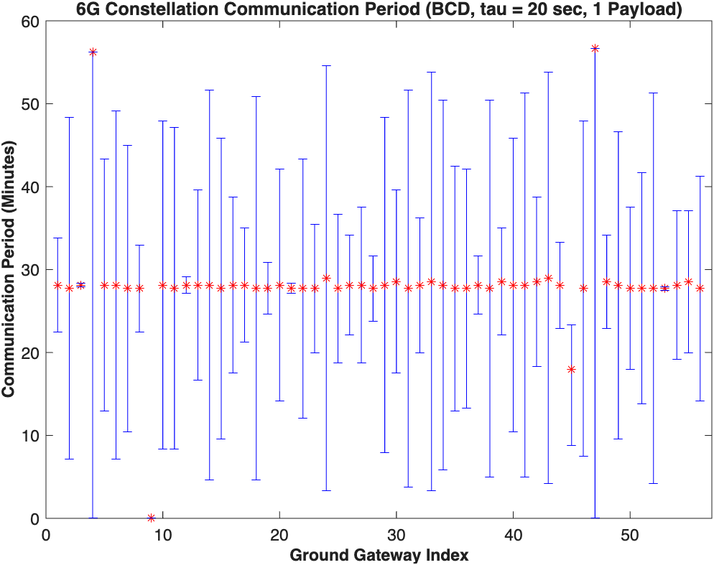
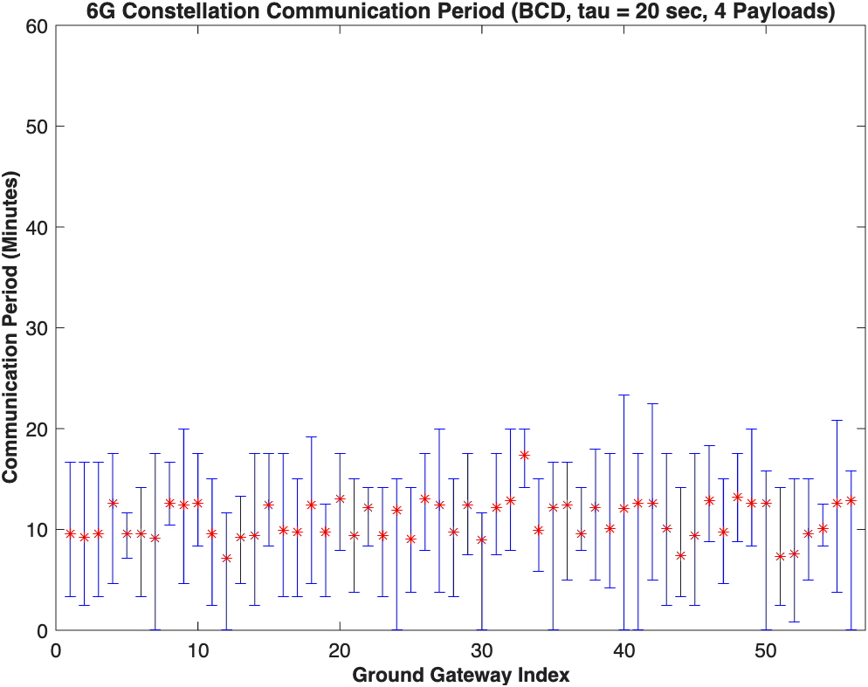

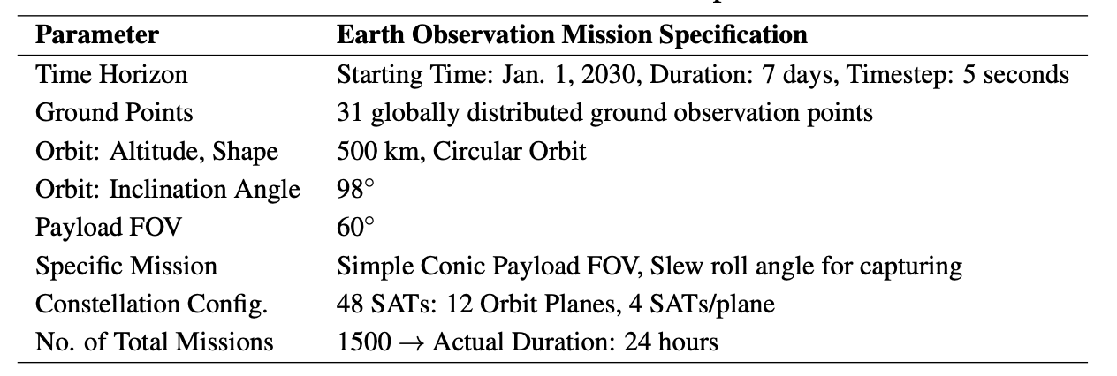




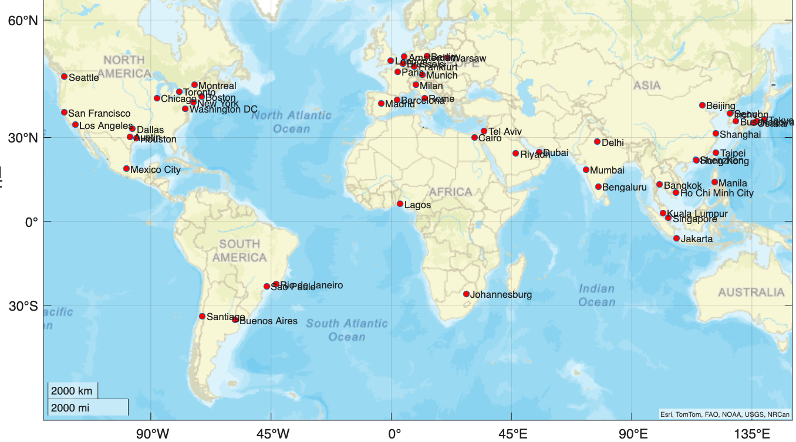
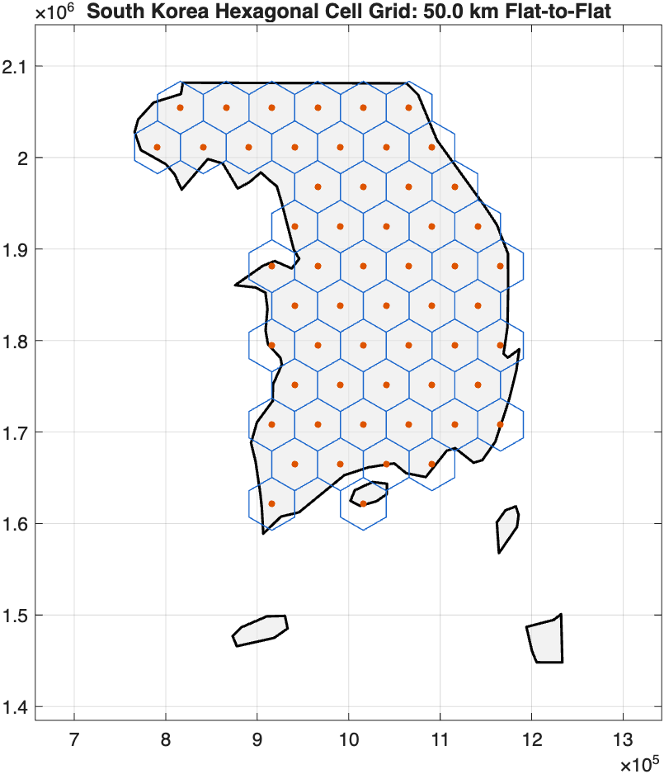
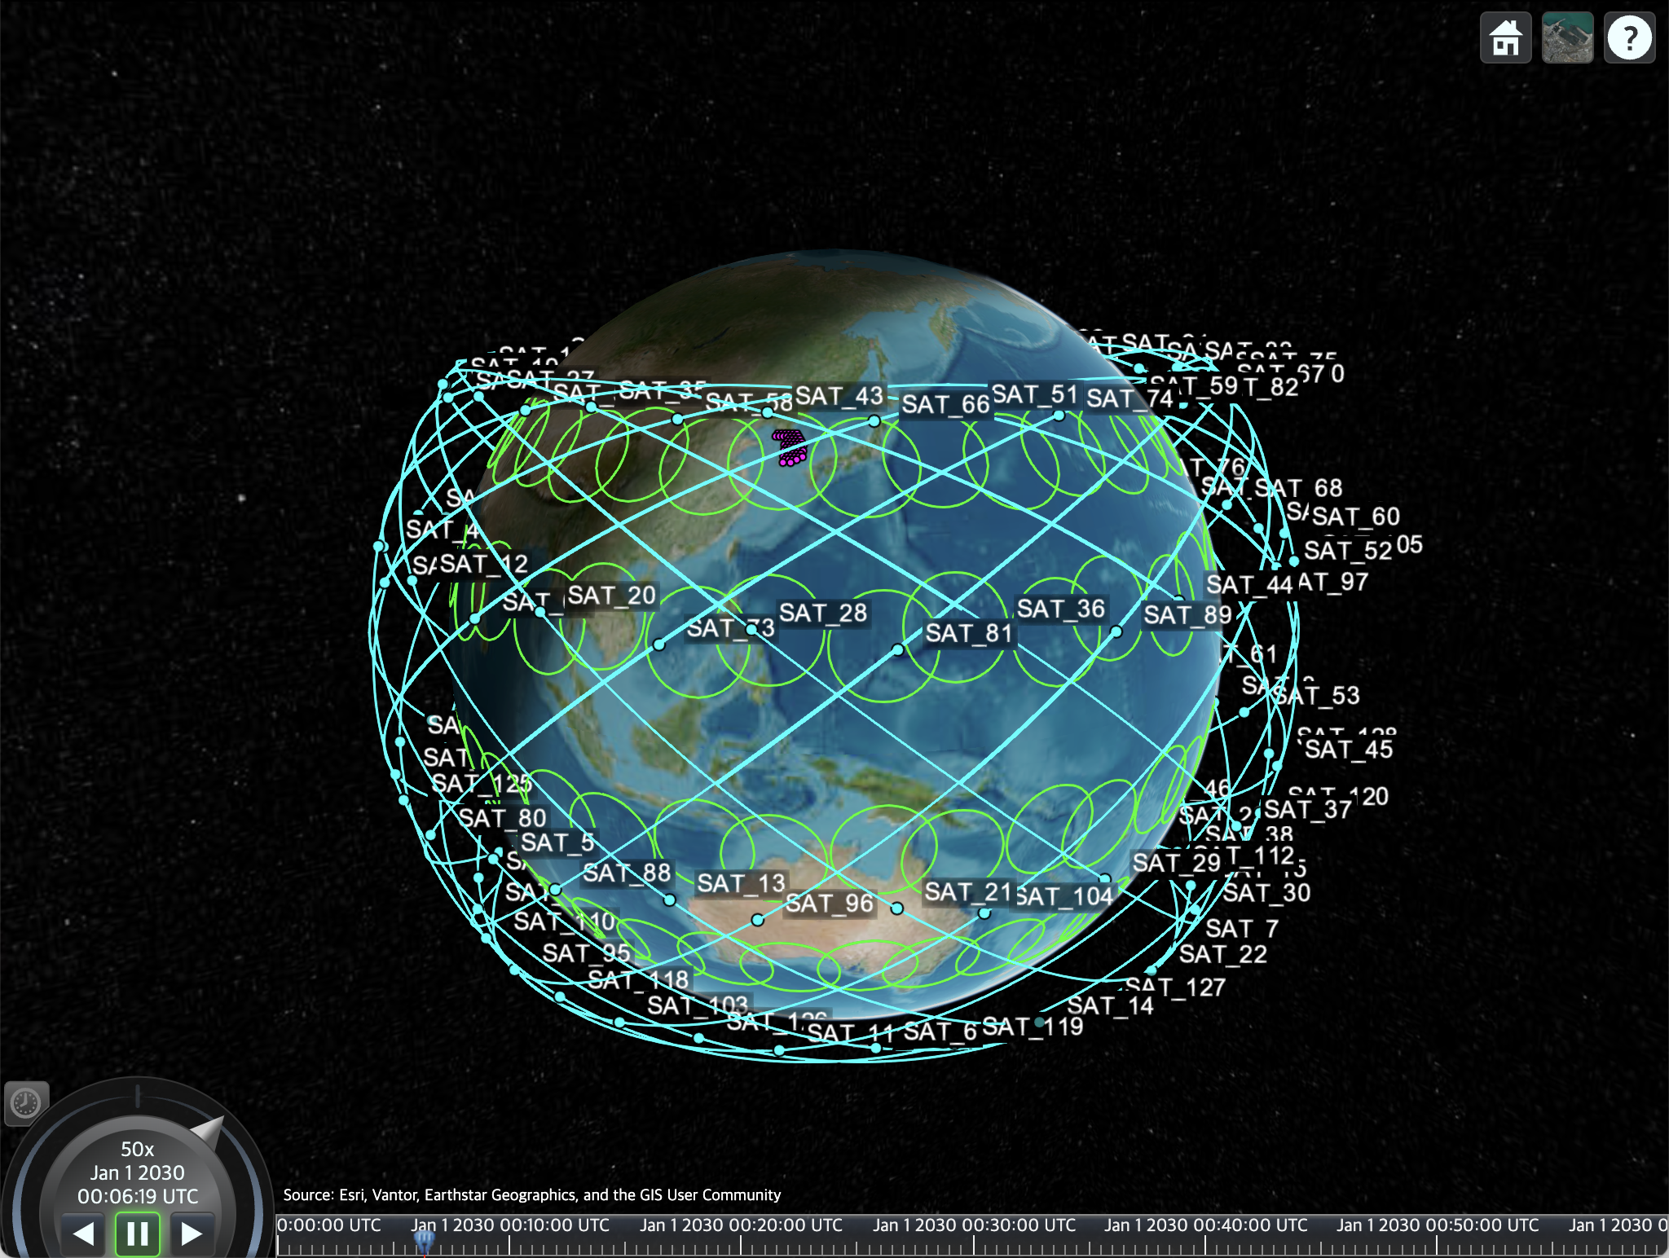
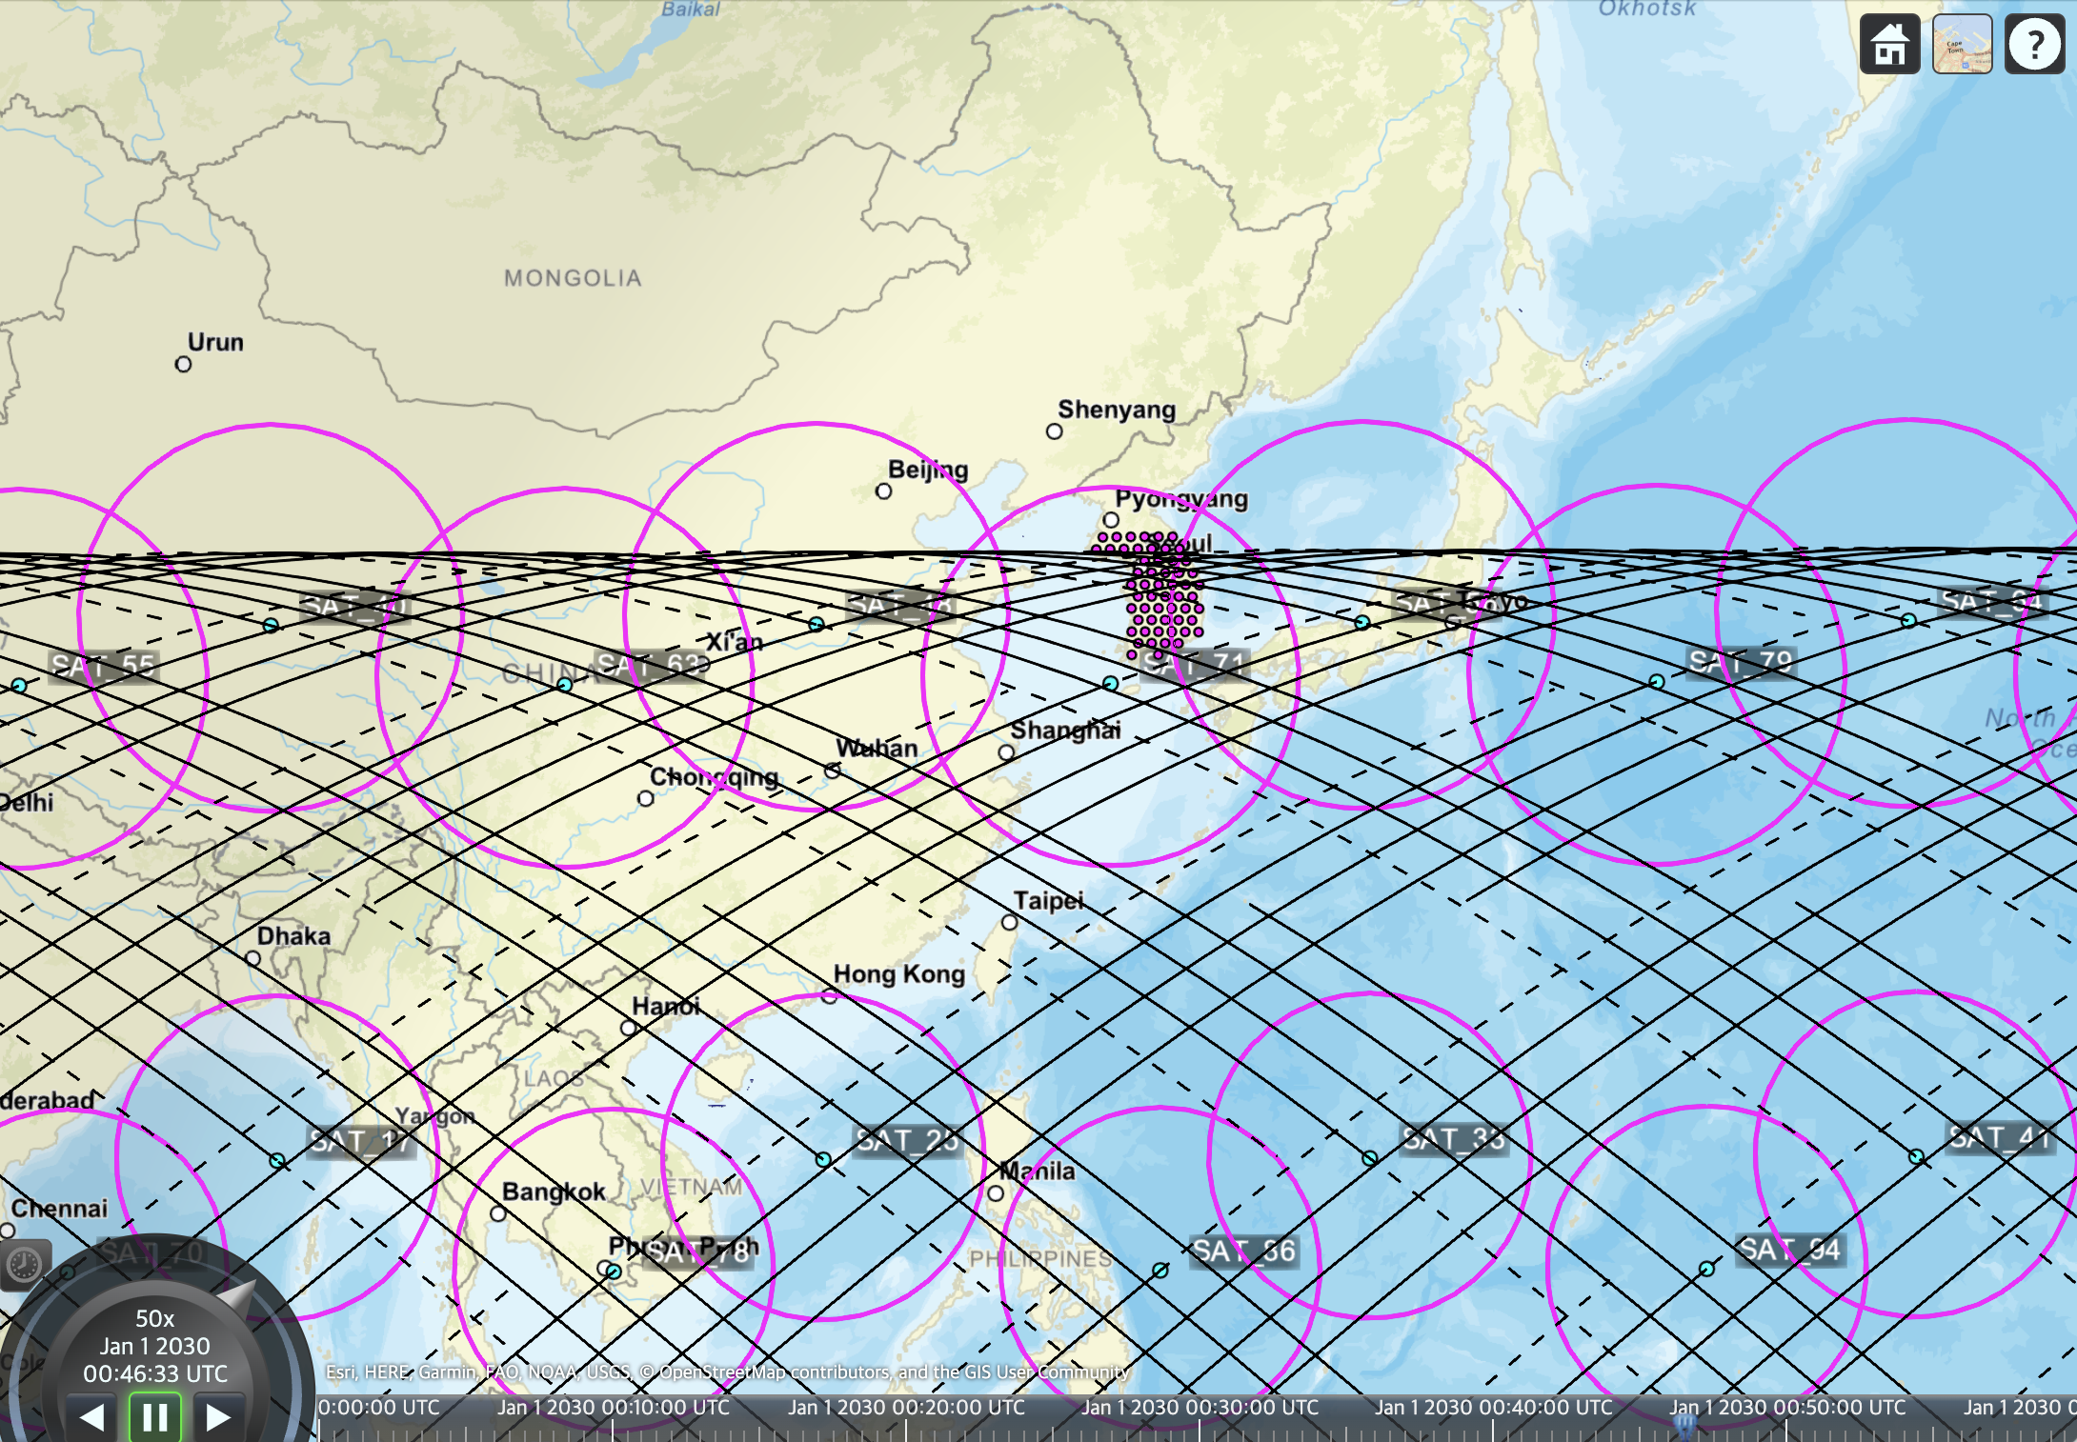
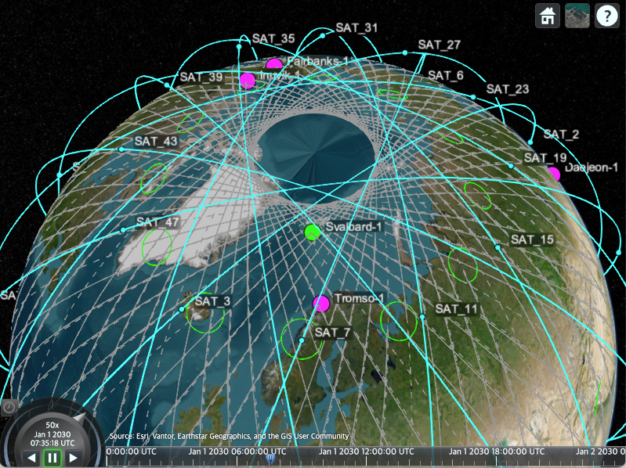
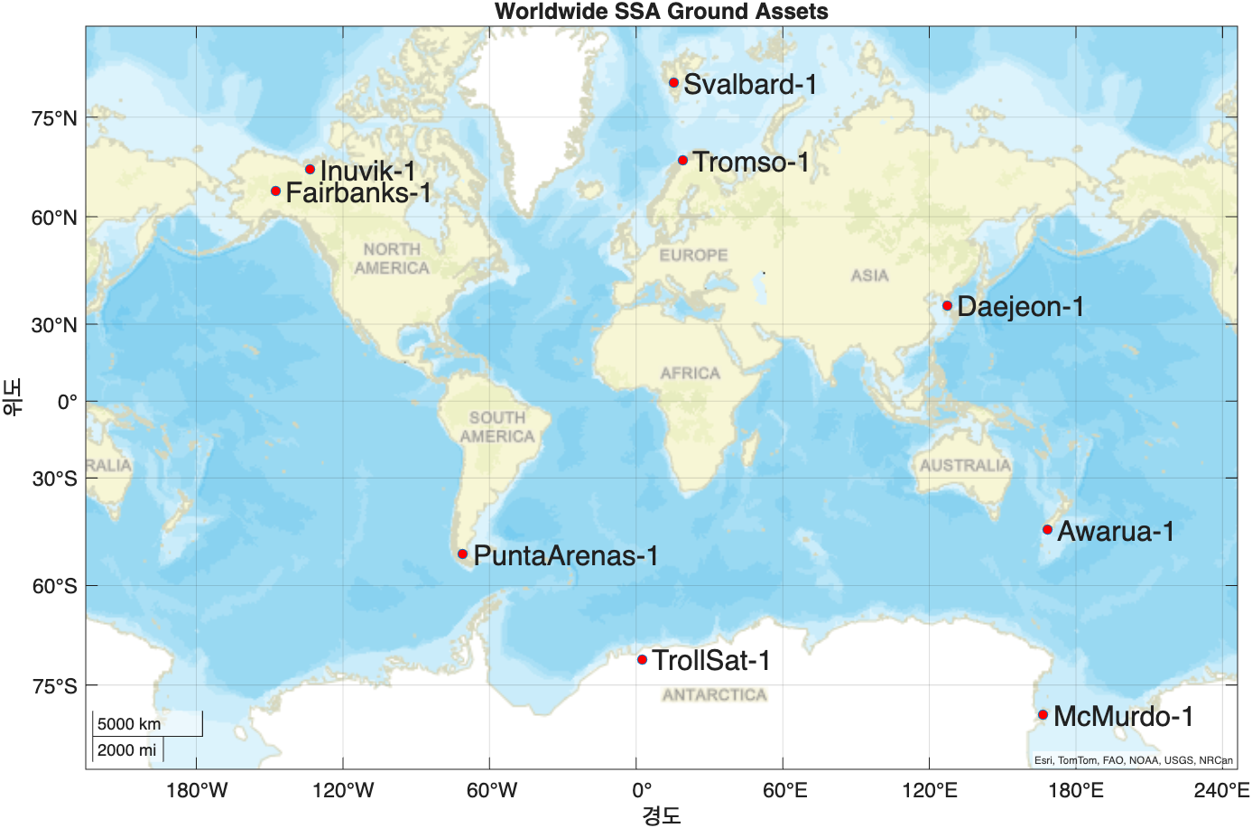
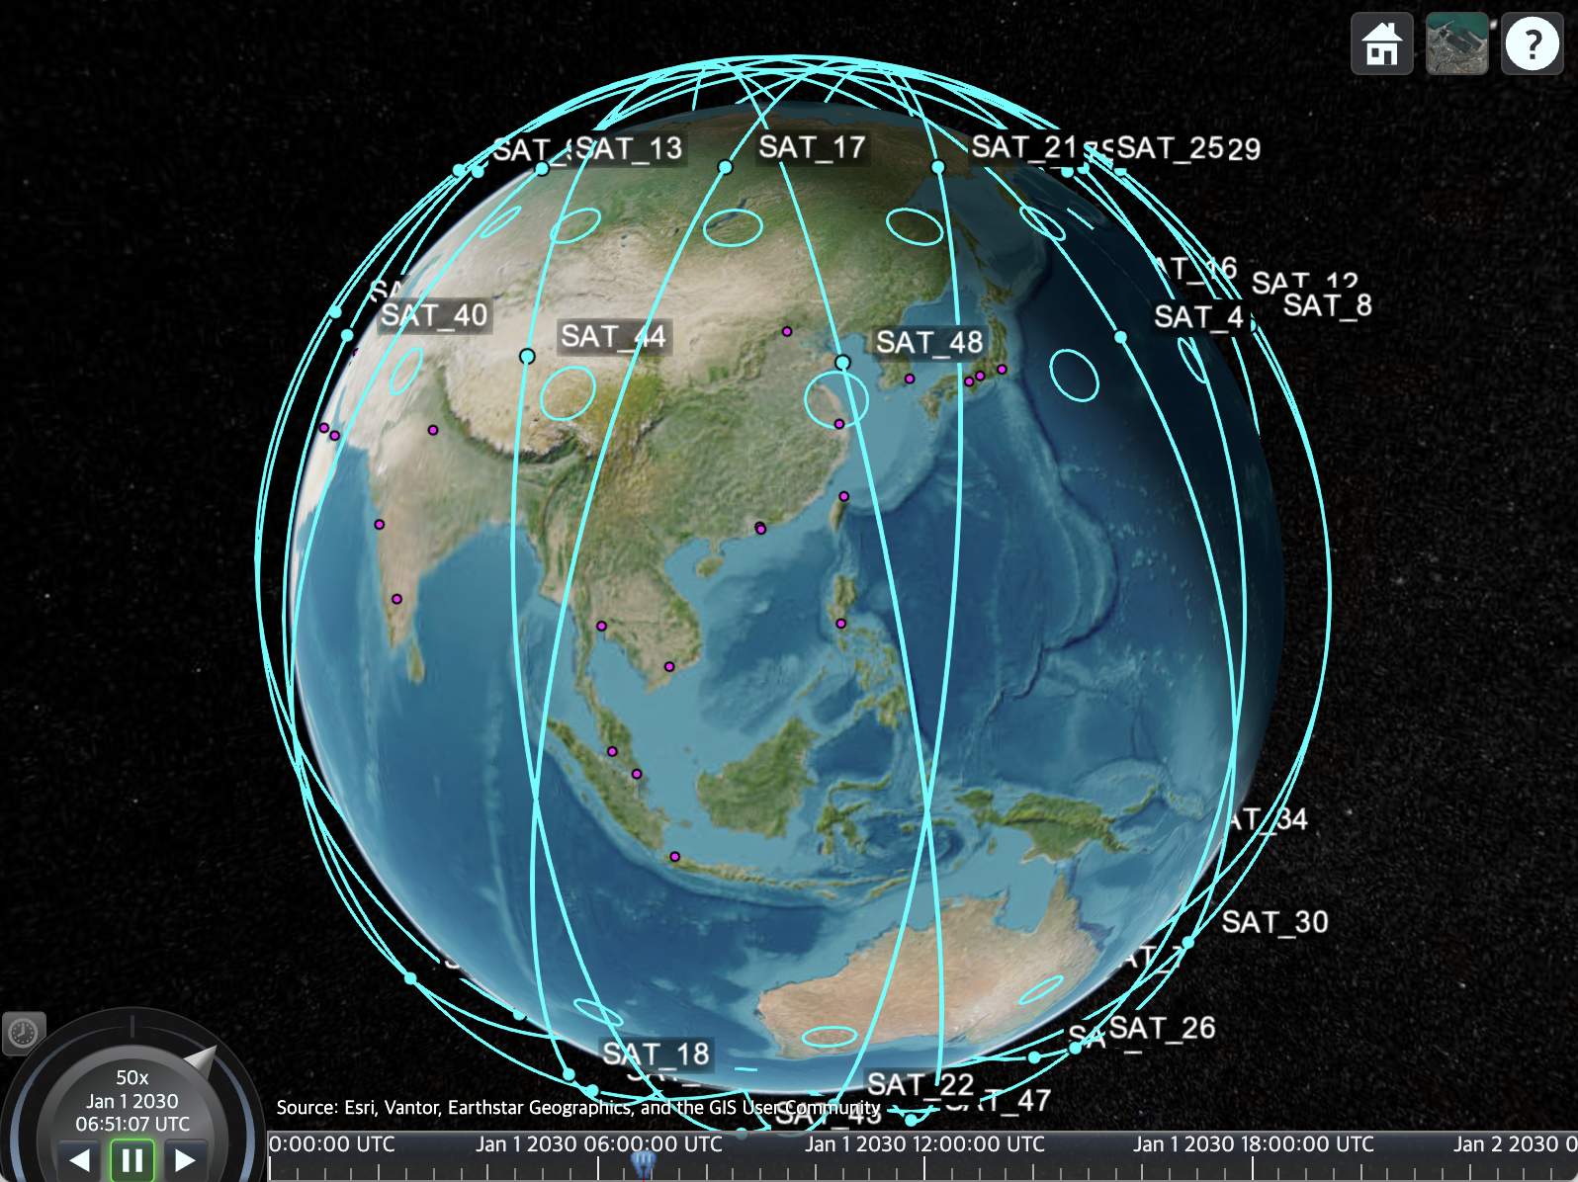
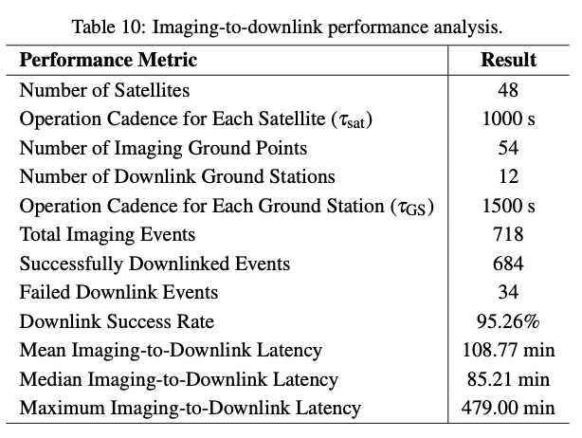

Distributed Optimal Scheduling of LEO Constellations for Ground Based Assets
Hongseok Kim¹, Maruthi R. Akella¹ ¹Department of Aerospace Engineering and Engineering Mechanics , The University of Texas at Austin
redstone@utexas.edu
WayFinder Space, Inc.
Overall Framework
REDSTONE Formulation
Sequential Block-Coordinate Descent
REvisit-time Determination and Satellite Tasking OptimizatioN Equations
L₁ Problem: Maximize number of contacts
Constants
L₂ Problem: Minimize Square-sum Revisit Time
L$∞$ Problem: Minimize Maximum Revisit Time
Earth-Observation
6G Telecommunication Network
Distributed SSA Scheduling
Selected Simulation Results
1. Earth Observation SAT image Capture Scheduling
2. 6G SAT Data Downlink/Uplink Scheduling (with ISL)
3. Distributed Ground Asset Scheduling for SSA
4. Earth Observation Imaging-to-Download Sequence

